Slide 1

FEM 3105
STRESS AND COPING
WEEK 4
FACTORS INFLUENCING STRESS TOLERANCE: PERSONAL

Slide 2



LEARNING OBJECTIVES
To describe personal factors known to influence the stress & coping process among individuals & families.
To identify & measure stress vulnerability factors.

Slide 3
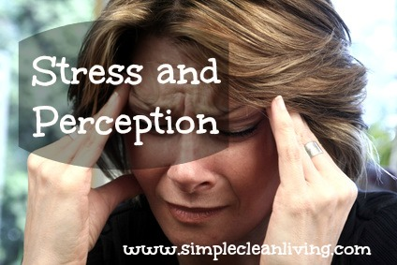
PERSONAL FACTORS
Individual Perception and Definition
Individual Personality
Self Concept
Locus of Control
Emotional Quotient (EQ)

Slide 4
PERCEPTIONS OF THE STRESSOR & COPING
Perception : type of stressor
  Normative or non-normative?
Perception : duration of stressor
  Brief or long term?
Is the stressors external or internal to self or family?
Perception of effects
  Positive or negative?
Perception of ability to handle or control stressor?

Slide 5
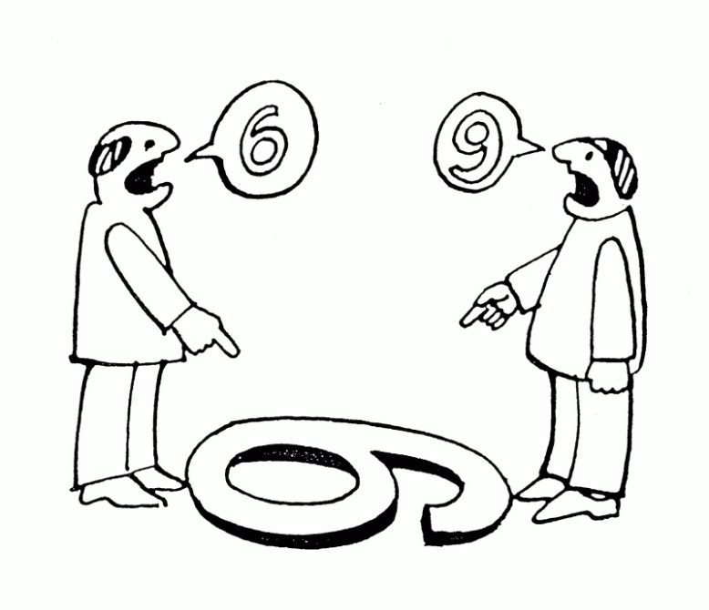
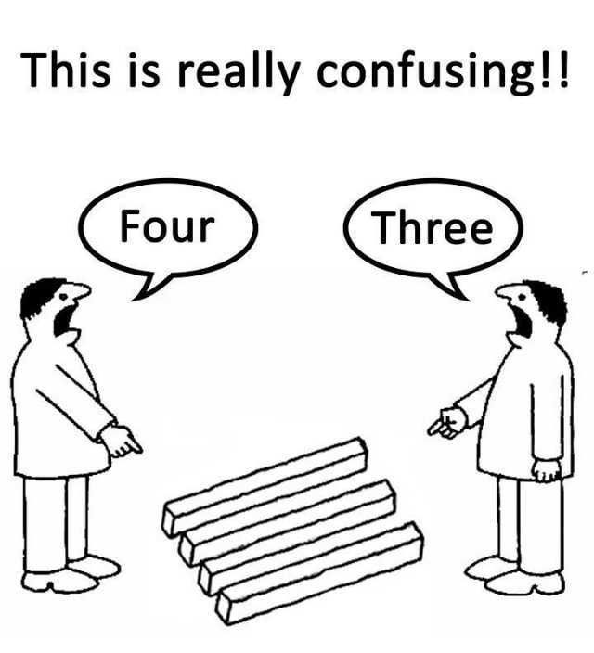
If you can’t change the situation, you must change the way you PERCEIVE the situation.

Slide 6
CONTROLLABILITY
Controllability is another factor that will affect the perception of stress. People tend to appraise uncontrollable events as being more stressful than controllable events (Miller, 1979). There are two types of control:
BEHAVIOURAL
  Behavioural control means performing some action.
COGNITIVE
  In the case of cognitive control, we can affect the impact of the events by using some mental strategy, such as distraction or by developing a plan to overcome the problem.

Slide 7
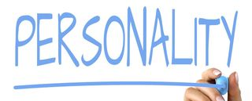
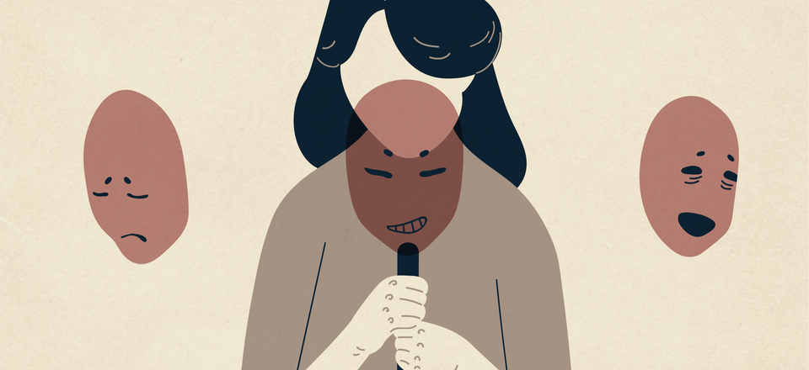

Slide 8
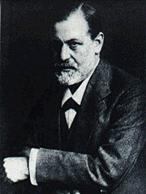
FREUD
Stress comes from the tension between your id (impulses) and the superego (society). This is controlled by the ego (identity). You try to use defense mechanisms to protect your ego.

Slide 9
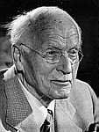
JUNG
Your personality arises through individuation. Stress may result from conflicts between your conscious and unconscious.

Slide 10
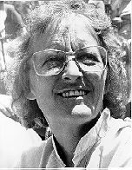
KUBLER-ROSS
The stages of handling
unmet expectations are
similar to the stages of
dying: denial, anger,
bargaining, depression,
and finally acceptance.

Slide 11
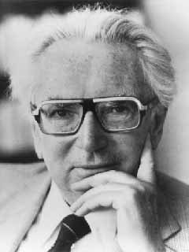
FRANKL
Stress can arise from the
failure to make meaning
out of life and suffering.

Slide 12
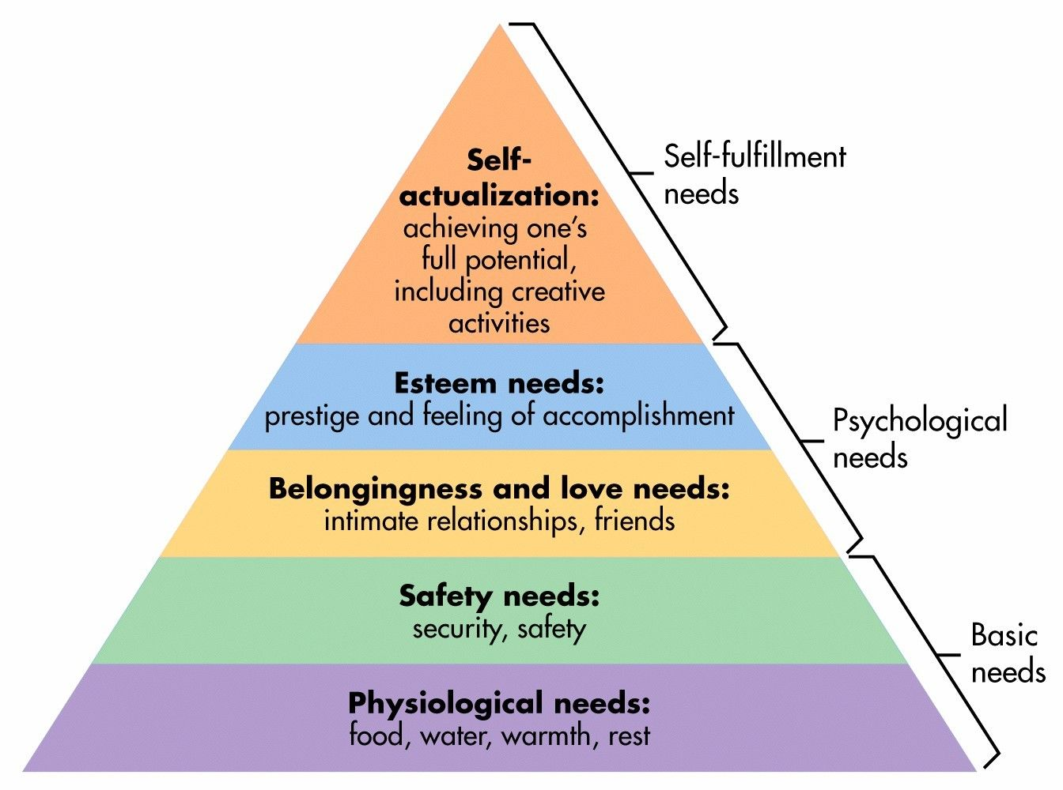
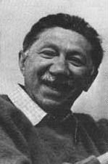
MASLOW'S HIERARCHY OF NEEDS
Look to my hierarchy of Needs. Stress occurs when lower level needs are not met, which keeps the person from reaching higher levels.
Maslow's hierarchy of needs is a motivational theory in psychology comprising a five-tier model of human needs, often depicted as hierarchical levels within a pyramid. Needs lower down in the hierarchy must be satisfied before individuals can attend to needs higher up.

Slide 13
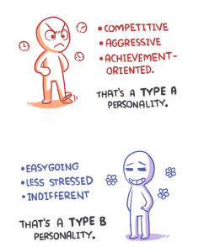
WHAT IT REALLY MEANS TO HAVE A TYPE A PERSONALITY…
Personalities can be categorized in a number of ways. Maybe you’ve taken a test based on one of these approaches, such as the Myers-Briggs Type Indicator or the Big Five inventory.
Dividing personalities into Type A And Type B is one method of describing different personalities, though this categorization can be seen as more of a spectrum, with A and B on opposite ends. It’s common to have a mix of type A and type B traits.

Slide 14
TYPE A PERSONALITY
According to the American Psychological Association, Type A personality refers to “a complex pattern of behaviours and emotions that includes an excessive emphasis on competition, aggression, impatience, and hostility.”
Generally speaking, people with a type A personality are often characterized as being:
  driven
  hardworking
  determined to succeed
They’re often quick and decisive, with a tendency to multitask. They may also experience high levels of stress.
Having a type A personality often means you find your time very valuable. People might describe you as motivated, impatient, or both. Your thoughts and internal processes likely focus on concrete ideas and the immediate tasks at hand.
A sense of urgency around work may lead you to try tackling multiple things at once, often without a break. You may also be prone to criticizing yourself, especially if you had to leave something undone or feel you didn’t do a good job.
Generally, if you have a type A personality, you may have …..
  Anxious reactive personality
  “Hardiness/Resilience”

Slide 15
Anxious-Reactive Type
Consistently over reacts
Easily becomes anxious, and continues to be anxious even after the stressors is gone
Tendency to “catastrophize” stressors
Difficulty in forgetting negative experiences
“Hardiness/ Resilience”
By Suzanne Kobasa 1979
Hardiness is a personality construct consisting of the three interrelated components of challenge, control and commitment suggested as a stress resilience factor (Kobasa, 1979).

Slide 16
3 KEY BELIEFS THAT HELPED TURN ADVERSITY INTO AN ADVANTAGE
The COMMITMENT attitude led them to strive to be involved in ongoing events, rather than feeling isolated.
The CONTROL attitude led them to struggle and try to influence outcomes, rather than lapse into passivity and powerlessness.
The CHALLENGE attitude led them to view stress changes, whether positive or negative, as opportunities for new learning.
Characteristics of “stress-resistant” individuals
Flanerry, 1990
Individuals that are stress resistant and stress tough appears to be balanced, happy, creative, resourceful and strong, even when faced with multiple psychosocial stressors and difficult situations.
The stress resistant and stress tough person is psychologically strong, has a positive attitude and purpose, keeps life in perspective, has a good sense of personal control and lives well.
In short, the stress resistance characteristics seem to serve as a buffer against stress and help to rebound quickly from difficulties!

Slide 17
TYPE B PERSONALITY
People with a Type B personality are often described as easy-going, relaxed, and highly flexible. The type B personality is basically the opposite of the type A.
The type B personality is characterized by a set of traits that include:
  Flexibility
  Low stress levels
  Relaxed attitude
  Adaptability to change
  Even-tempered
  Laid-back
  Tendency to procrastinate
  Patience
  Creativity
It is important to remember that everyone tends to experience the above traits to some degree from time to time. People with the type B personality, however, exhibit these personality traits more often than not.
Here are some things you should remember when you are interacting with a type B personality:
  They have a plan, but it’s probably in their heads.
  They work well in groups.
  They don’t like to be rushed.

Slide 18
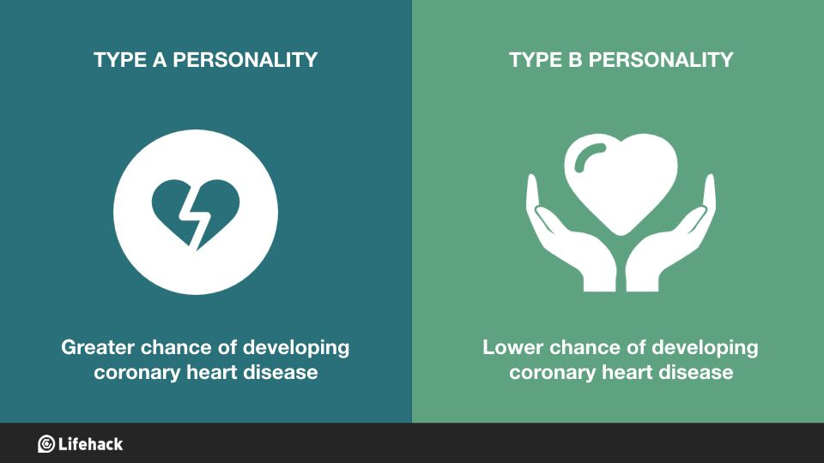
Personality factors that influence how one responds to stress…
The Type A behavior pattern consists of three characteristics:
  Competitive achievement orientation,
  Time Urgency
  Anger or Hostility
You may also be more inclined to have a short temper.
Associated with increased risk of heart disease which may have more to do with hostility.
Type B Personality behavior pattern consists of three characteristics:
  Relaxed
  Patient
  easygoing
Individuals with a Type B personality work steadily, enjoying achievements, but do not tend to become stress when goals are not achieved.
People with Type B personality tend to be more tolerant of others, are more relaxed than Type A individuals, more reflective, experience lower levels of anxiety and display a higher level of imagination and creativity.

Slide 19
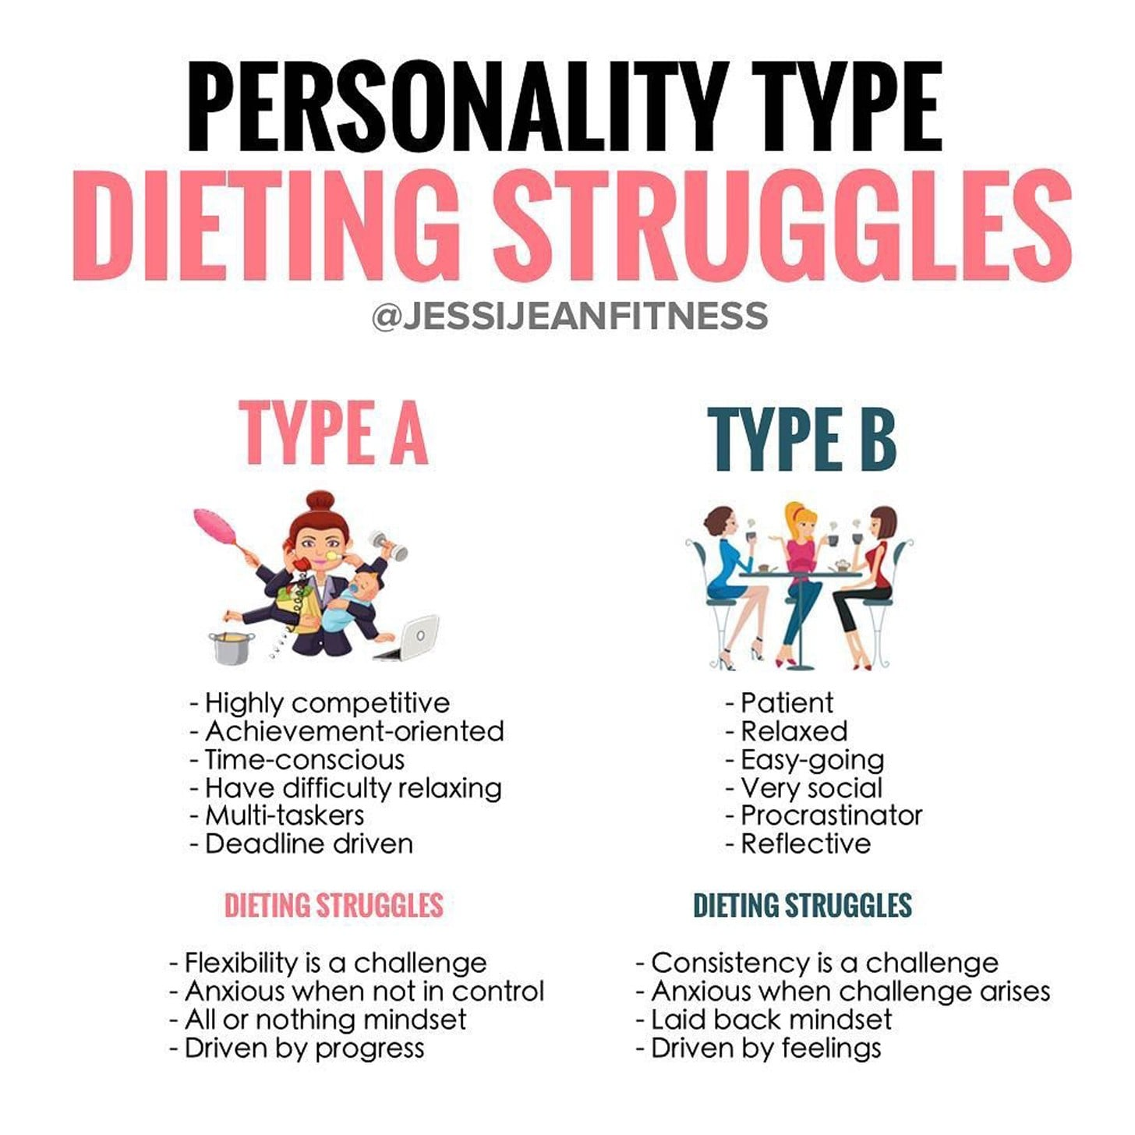
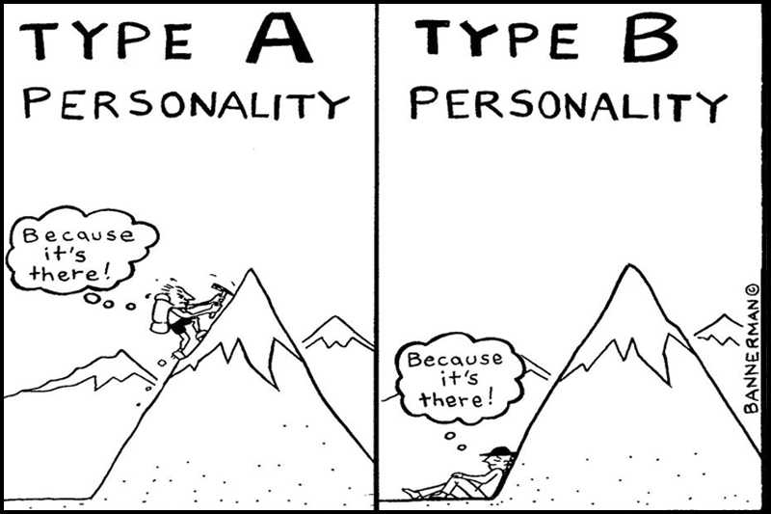

Slide 20
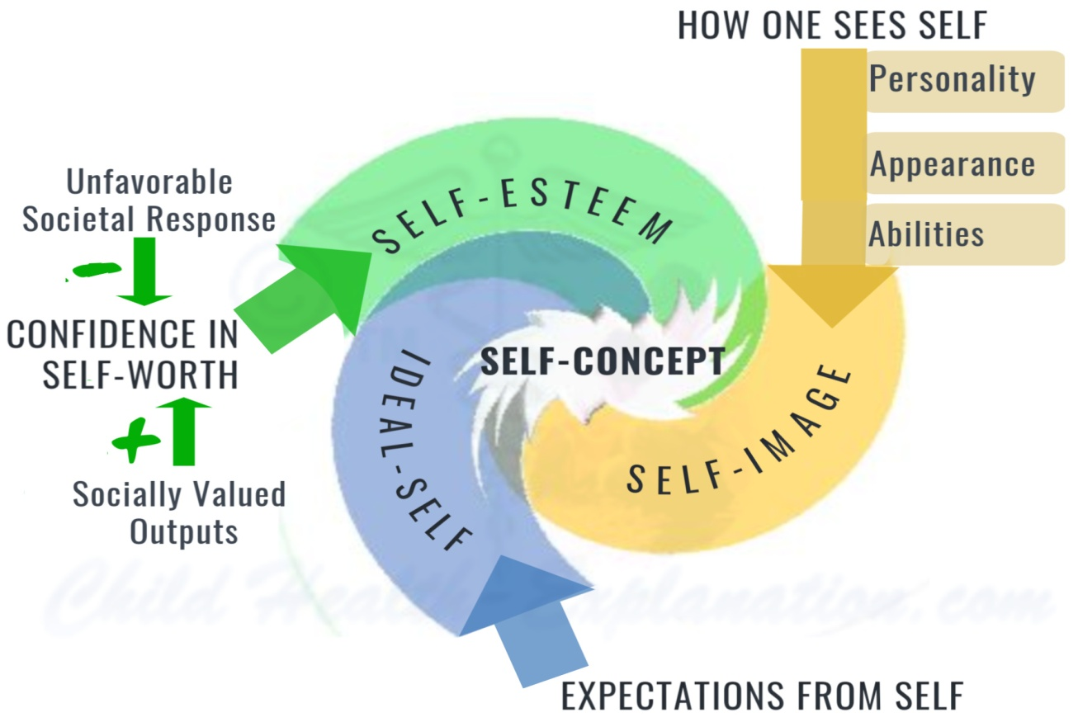
Self -Concept
The self-concept is a factual description of how you perceive yourself. If your perception is distorted, this description may not be an accurate depiction of you, but it is an accurate statement of what you believe about yourself.
Self-concept : self image; each individual is unique with own self-concept.
The self-concept is derived from self-esteem and self-efficacy. If a person has low self-esteem, the self-concept may be skewed in the direction of a negative description.
Those components are:
  self-knowledge
  ideal-self
  self-image
Notes:
Positive traits? Sense of humor, punctual, friendly
Negative traits: easily get angry, jealous of others
ONLY WE KNOW WHO WE ARE – WHAT WE HAVE INTENDED TO DO AND ACTUALLY DONE
WHAT WE HAVE THOUGH AND FELT
AND WHAT WE HAVE HOPED FOR
OUR “SELF” IS A LIFELONG ACCUMULATION OF IMPRESSIONS
HOW WE SEE AND EVALUATE OURSELVES HAS A TREMENDOUS IMPACT ON SELF-ACCEPTANCE

Slide 21
Self Concept consists of:
Self Awareness (kesedaran kendiri)
Self Esteem /
Self worth
Self Confidence
Self Love
Self Respect
Self Efficacy

Slide 22
WHAT IS SELF-ESTEEM?
Self-esteem is the regard or respect that a person has for oneself.
In psychology, the term self-esteem is used to describe a person's overall subjective sense of personal worth or value. In other words, self-esteem may be defined as how much you appreciate and like yourself regardless of the circumstances. Your self-esteem is defined by many factors including:
  Self-confidence
  Feeling of security
  Identity
  Sense of belonging
  Feeling of competence
Other terms that are often used interchangeably with self-esteem include self-worth, self-regard, and self-respect.
Self-esteem tends to be lowest in childhood and increases during adolescence, as well as adulthood, eventually reaching a fairly stable and enduring level. This makes self-esteem similar to the stability of personality traits over time.

Slide 23
WHAT IS SELF-EFFICACY?
According to Albert Bandura, self-efficacy is "the belief in one's capabilities to organize and execute the courses of action required to manage prospective situations."
Self-efficacy is a person's belief in his or her ability to succeed in a particular situation.
It generally corresponds to the level of competence an individual feels. Competence can vary from one situation to another. For instance, a person might feel quite capable competing in a particular sport but may not feel competent speaking in front of a group. As a result, overall self-efficacy may not be completely accurate as it is assessing an individual's general feelings of competence across a variety of situations or tasks.
Individuals react and deal with stress in different ways depending on their past experiences and success and failure with dealing with stress. Individuals who learn and use effective coping strategies to deal with stress will most likely develop a positive self-concept. People who become overwhelmed with stress may feel hopeless and powerless, leading to a feeling of low self-confidence and self-esteem. We may need to teach the client effective coping strategies and techniques for handling stress.

Slide 24
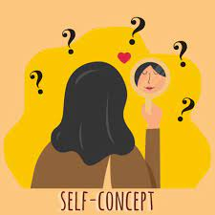
Factors Affecting Self-concept
There are various factors that can affect self-concept, these include age, sexual orientation and also gender.
Also, factors such as:
  Health status like illness, injury, body change, loss of control, dependency on others
  Role stressors like overload, strained, feelings of inadequacy
  Developmental transitions – aging in our culture
  Personal “success” or failure history
  Crisis and/or life events: personal and/or global
  Internal and external resources
  Individual perception of crisis
Notes:
Health Status: Illness…produces anxiety….which can compromise recovery...which can lead to decreased self-concept….I’ll never get better or I’m useless now.
Roles stressors: roles have responsibility whether mother caring for child, breadwinner in the family, health care giver to family members etc. student homework, office deadlines…Our roles can cause stress which can affect our self-concept…can become stressed, overwhelmed and unable to cope…
Developmental changes: going through menopause is a dev. change may feel old….or less womanly etc.. STRESSORS THROUGHOUT DEVELOPMENT – CAN BE RESOLVED POSITIVELY OR NEGATIVELY (ERIKSON)
AGING STRESSORS IN OUR CULTURE PARTICULARLY HIGH
HX OF SUCCESS OR FAILURES
INTERNAL AND EXTERNAL RESOURCES
CRISIS OR LIFE STRESSORS: JOB CHANGE, SCHOOL, DIVORCE
CRISIS; PERSONAL OR GLOBAL(9/11)
A PERSON’S RESPONSE IS DETERMINED BY (3) THINGS:
PERCEPTION OF THE CRISIS
DEGREE OF EXTERNAL RESOURCES
EXTENT OF INTERNAL RESOURCES

Slide 25
Self Concept & Stress
Generally, the more positive or better self concept lead to better coping skills, or least confident of overcoming stressors.
Self fulfilling prophecy - you are what you believe yourself to be!
Perceptions of hopelessness & self devaluation can lead to increased stress levels
High self-esteem vs Low self-esteem
Passive “who cares attitude”
Excessively Dependent
Hesitant to express views
Overly Critical of self
Monotone voice – lack of emotion & energy
Neglects own needs
Difficulty making decisions
Overly apologetic
Avoidance of eye contact
Assertive
Self-directed
Makes decisions
Praises self
Speaks clearly
Attends to needs

Slide 26
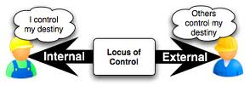
Are You The Master
Of Your Fate?
-J.B. Rotter (1966)
Generalized Expectancies for Internal Versus External Control of Reinforcement

Slide 27
LOCUS OF CONTROL
(Rotter, 1966)
The extent to which an individual believes they are in control of their destiny (internal LOC) or are at the mercy of events (external LOC).
Locus of control refers to one’s general predisposition to perceive control, or lack there of, across various situations. The extent to which one attributes valued outcomes or reinforcement to either internal or external circumstances reflects their dimension of locus of control.
Individuals with an internal locus of control believe in the power of their own decisions and behaviours to impact life events and determine their own future.
Those with an external locus of control, on the other hand, view life events as dictated by environmental factors outside of one’s control, such as luck, fate, or powerful others.
EXTERNAL LOCUS OF CONTROL – belief that consequences of behavior are controlled by luck, fate, or powerful others
INTERNAL LOCUS OF CONTROL – belief consequences of behavior are controlled by own behavior

Slide 28
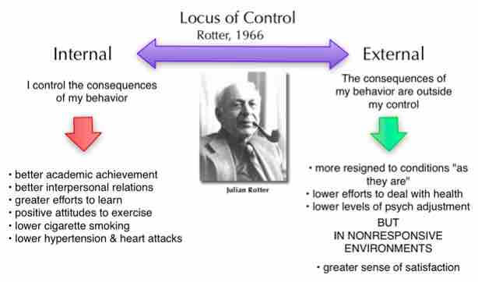
Examples of External and Internal Locus of Control
EXTERNAL
An external person scores an A on a test and concludes they got that grade because the teacher graded it wrong, someone switched the tests, it was just by chance, and/or it had nothing to do with them
INTERNAL
An internal person scores an A on a test and concludes they got that grade because they studied all week for it, they are good in the subject, and/or it was earned because of their behavior

Slide 29
THE PARADOX OF CONTROL
The more you try to take control of the world out there, the more out of control it seems.
The more you let go trying to control the external world (and stop blaming), and instead, respond in a way that you would deeply admire as wise, the more personal control you feel
Benefits of Control
When exposed to cold viruses, those who feel they are out of control are more likely to develop colds
Low-income individuals with high levels of control report similar quality of life to high-income individuals
Managers and executives have fewer illnesses
Individuals reporting more control have less problems with hypertension
Nursing home residents with greater control over activities are more alert, happier and live longer

Slide 30
Emotional Quotient (EQ)
Goleman (1996), individuals are believed to vary in their ability to perceive, process and manage information that is emotional in nature.
As such emotional intelligence is not about emotions per se, but more about the ability to use emotional information and integrate it with thoughts and actions.
EQ - individuals with higher emotional intelligence are somehow more successful at work and in their personal lives (Goleman, 1996).
Emotional Intelligence is the ability to:
  recognize emotions in self and others
  manage one’s own emotions
  empathize with others
  maintain successful relationships

Slide 31
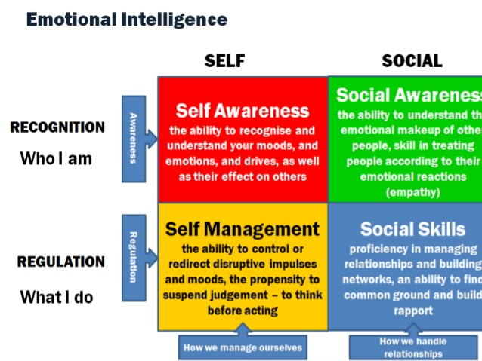

Slide 32

Stress Intensity: Eight factors
There is a significant difference between the top three factors and the bottom five. Can you figure it out?
  Predictability of stressor
  Duration of stressor
  Intensity of stressor
  Physiology
  Motivation
  Competence
  Social Support
  Cognitive Appraisal
Notes:
There is a significant difference between the top three factors and the bottom five. Can you figure it out?
People often have little control over the top three factors. People with an external locus of control focus on these factors, while a persona with an internal locus of control will focus on the factors that they can effect.
One of the best ways to prepare for stress is to be in good physiological shape. This would include an exercise program, a healthy diet, a meditation or prayer practice, and a sleep schedule that meets your needs.
When you are faced with a stressful situation, your motivation is a key factor in getting out of the stress. If you focus on what you can do and you are determined to do it, then you will deal with the stress better.
Making sure that your work skills are sound is a great way to be prepared for stress. If you are well informed, you will have more information and will be able to be more effective at problem-focused coping.
Having plenty of social support is necessary for those times when you need a shoulder to cry on or when there is nothing else that can be done.

Slide 33
Stress Intensity: Eight factors
People often have little control over the top three factors.
People with an external locus of control focus on these factors, while a person with an internal locus of control will focus on the factors that they can effect.
One of the best ways to prepare for stress is to be in good physiological shape. This would include an exercise program, a healthy diet, a meditation or prayer practice, and a sleep schedule.
When you are faced with a stressful situation, your motivation is a key factor in getting out of the stress. If you focus on what you can do and you are determined to do it, you will deal with the stress better.
Making sure that your work skills are sound is a great way to be prepared for stress. If you are well informed, you will have more information and will be able to be more effective at problem-focused coping.
Notes:
There is a significant difference between the top three factors and the bottom five. Can you figure it out?
People often have little control over the top three factors. People with an external locus of control focus on these factors, while a persona with an internal locus of control will focus on the factors that they can effect.
One of the best ways to prepare for stress is to be in good physiological shape. This would include an exercise program, a healthy diet, a meditation or prayer practice, and a sleep schedule that meets your needs.
When you are faced with a stressful situation, your motivation is a key factor in getting out of the stress. If you focus on what you can do and you are determined to do it, then you will deal with the stress better.
Making sure that your work skills are sound is a great way to be prepared for stress. If you are well informed, you will have more information and will be able to be more effective at problem-focused coping.
Having plenty of social support is necessary for those times when you need a shoulder to cry on or when there is nothing else that can be done.

Slide 34
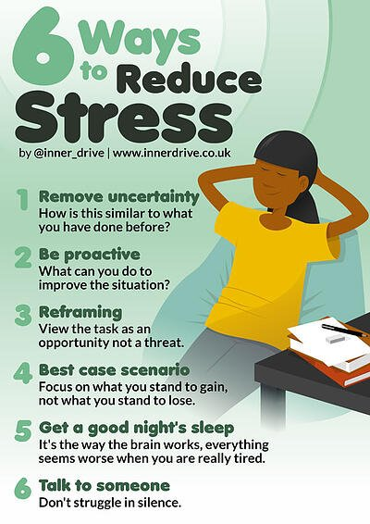
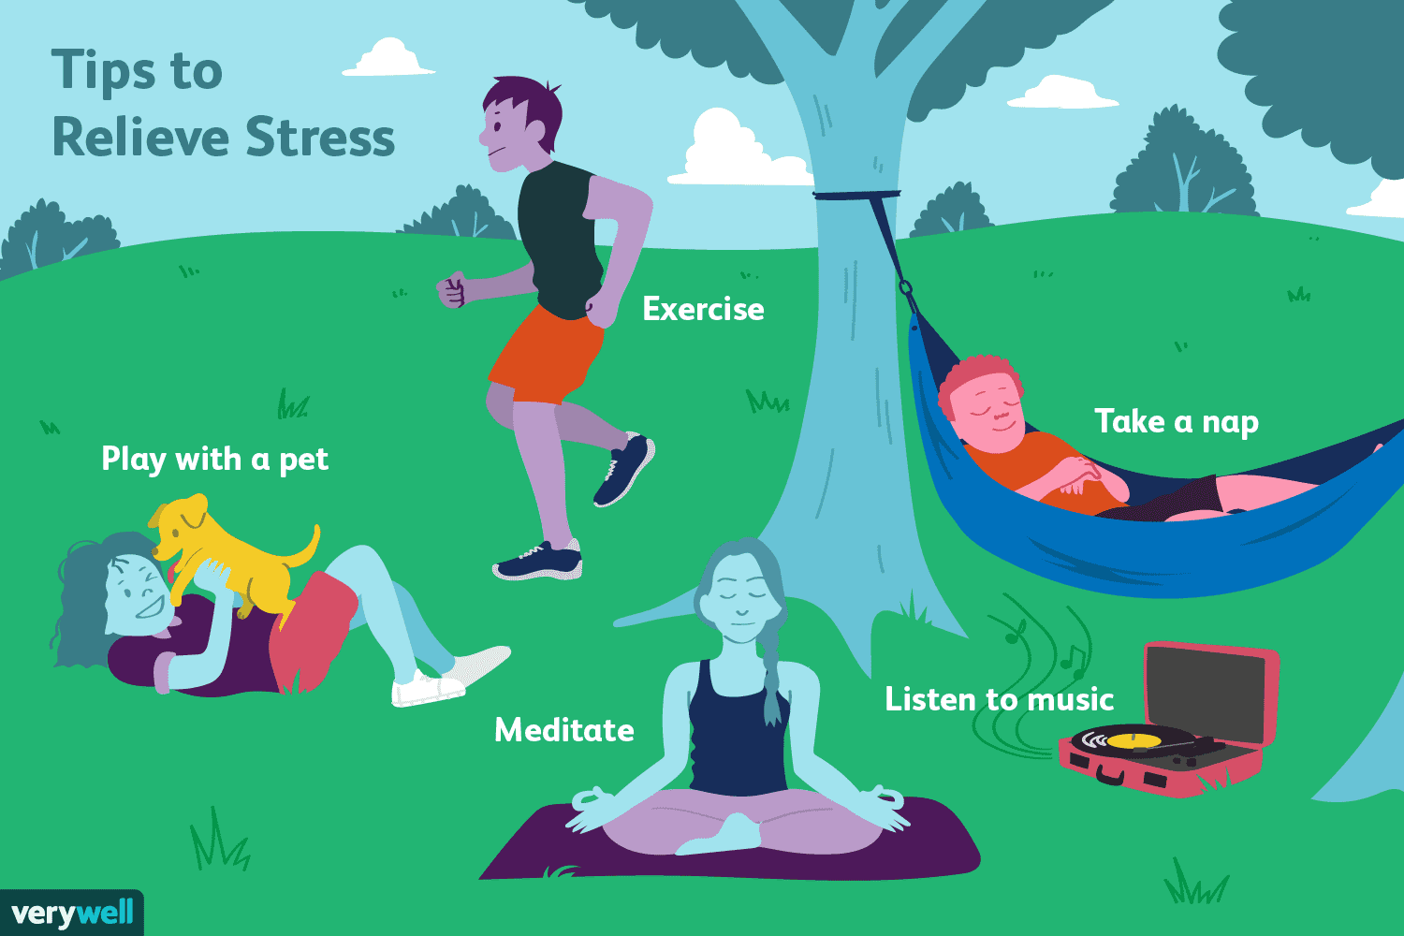
WAYS TO AVOID/RELIEVE STRESS

Slide 35
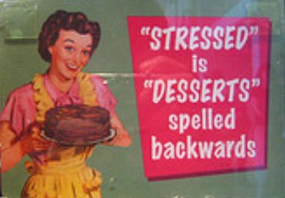
THANK YOU
THE END

